Slide 1
CS 205
Artificial Intelligence

Slide 2

Why Machine Learning?
too complicated (e.g., driving)
too fast (e.g., spam)

Slide 3
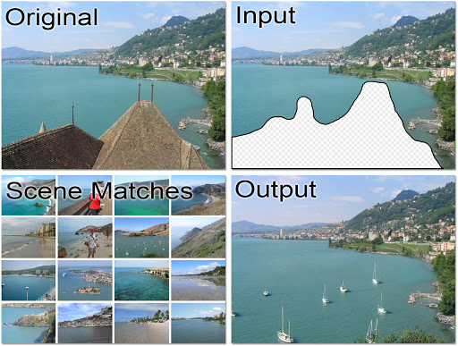
What is Machine Learning?
Algorithms that learn from data.
Decision problems that have numerous applications.
^^ which can be said of ANY algorithm.

Slide 4
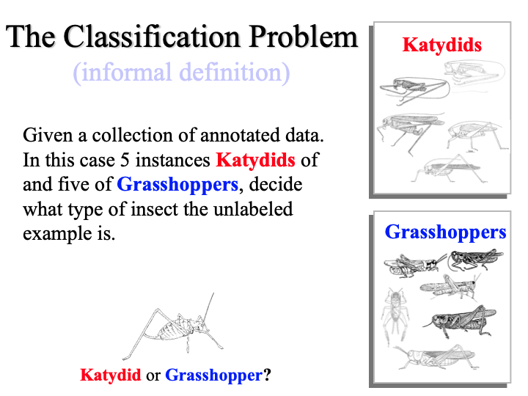
Classification
Given a collection of labeled data, decide what type is a new unlabeled instance.
Q: How is classification related to but different from prediction?
A: Are we predicting this is a katydid? No, it was always a katydid and we are just now recognizing (classifying) it as such. A: Weather is often a prediction problem, because it hasn't happened yet!

Slide 5
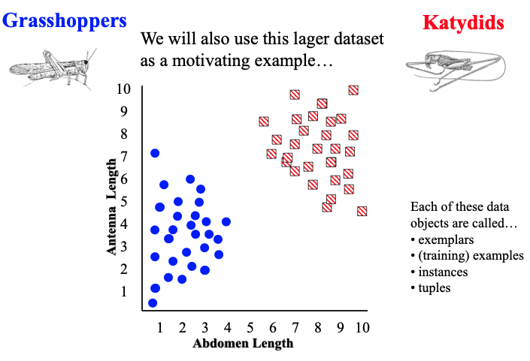
Classification
See Prof Eamonn's slides.

Slide 6
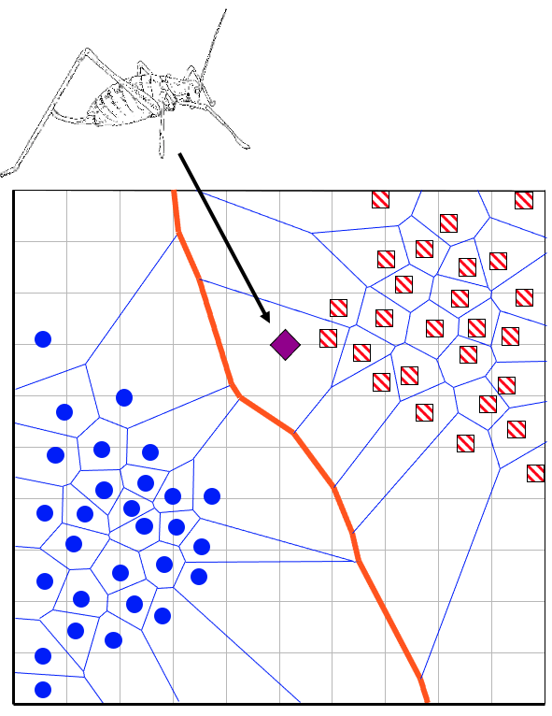
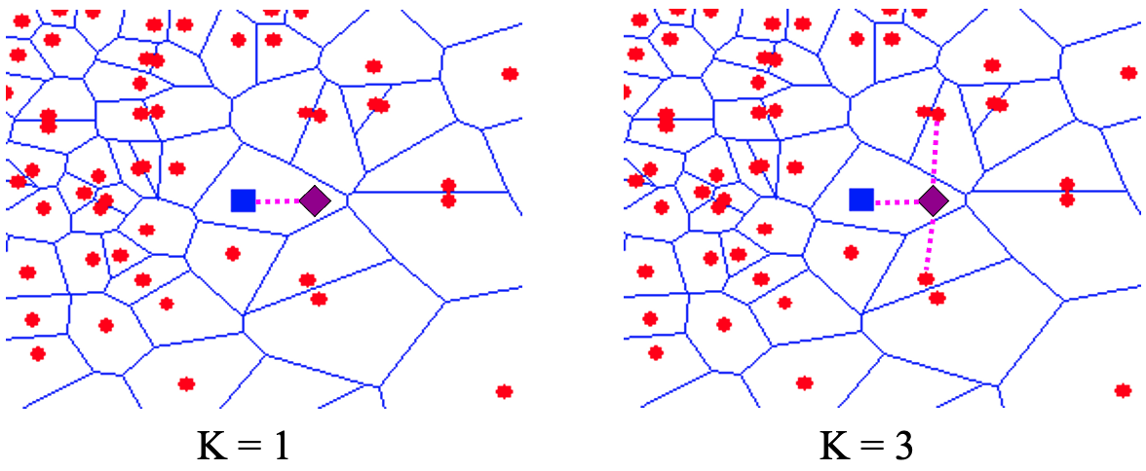
K-Nearest Neighbors
Easy to implement, just check:
Which are my nearest neighbors?
Assumption: I must me like one of them.

Slide 7
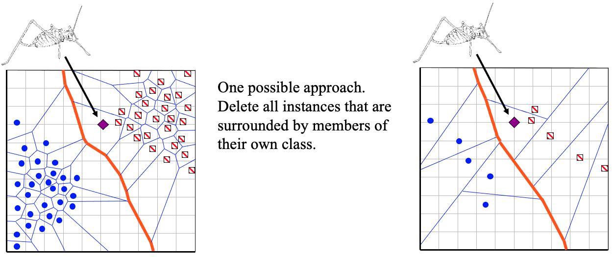
Issues with KNN
Sensitive to outliers: what if my nearest neighbor is a weirdo?
Computationally tractable, does not always mean practical.
What is the complexity of KNN?
What if I have a billion data points — how long does a single classification take?

Slide 8
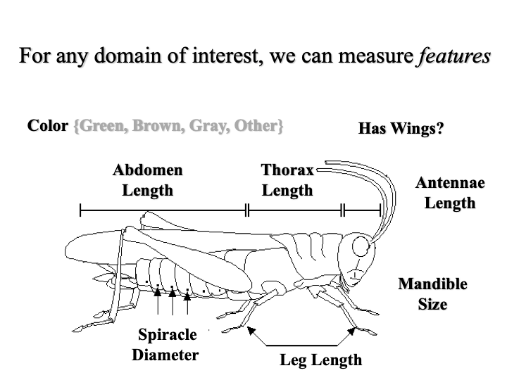
Features
Measureable inputs that may help separate or decide instances.
If you imagine rows of data instances in a matrix, features are often the columns or attributes of the data instances.

Slide 9
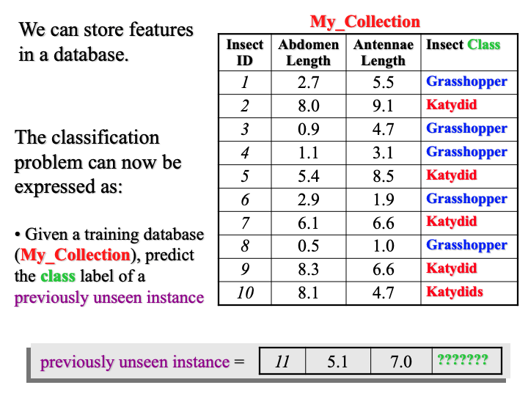
Features
Sometimes, the data you have simply does not do the job.
You may have the WRONG features and no amount of algorithm tricky will help.
Rather, you may simply need more data or more features.

Slide 10
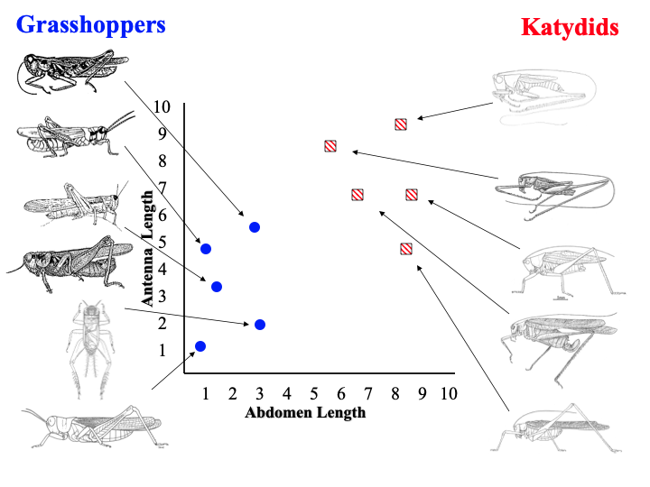
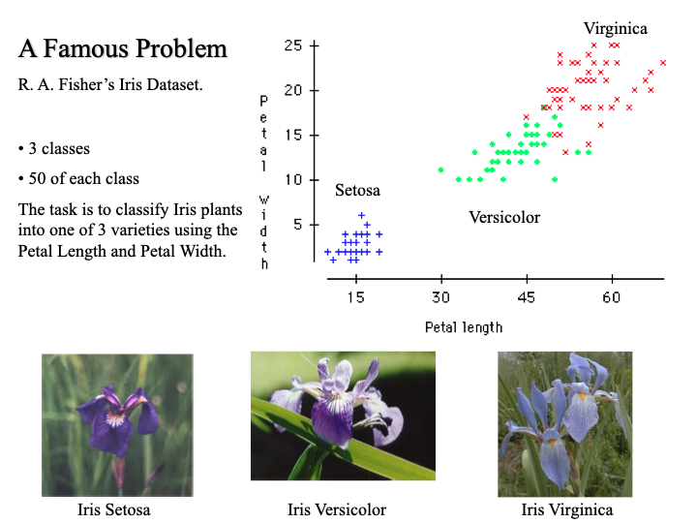
Features
Not all classes are equally easily decided.

Slide 11
Evaluation
Accuracy
Speed and scalability
time to construct model
time to apply model
latency and disk-resident data
Robustness
noise, missing values, irrelevant features, streaming data, portability
Interpretability
gaining insight from the model

Slide 12
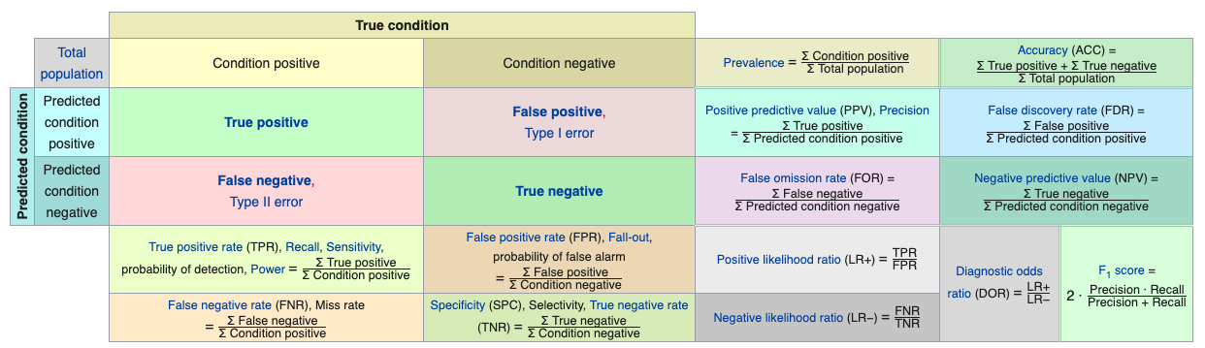
Accuracy
this is like god, an infallible being
Understand the tradeoffs between recall, precision and specificity.
Image source: Wikipedia
"accuracy" is only one way to look at it
this is your algorithm, flawed and imperfect

Slide 13
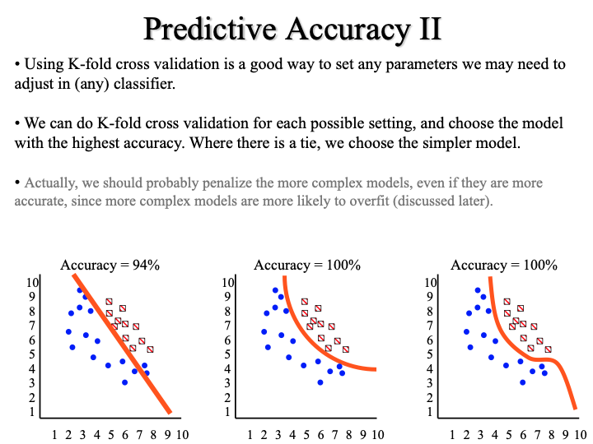
Cross-validation
What is K-fold cross validation?
What is the difference between "validation" and "evaluation"?

Slide 14
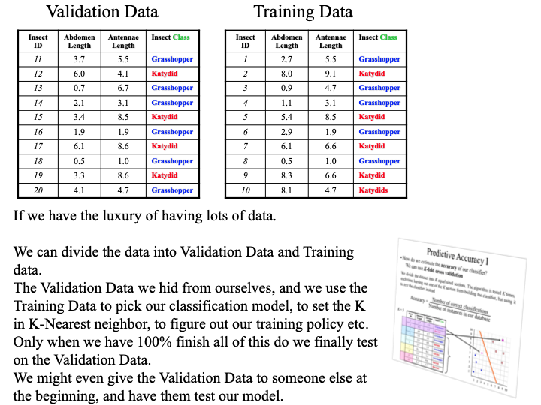
Evaluation
Internal versus external validation.
Cross-validation does not equate with external validation, a common mistake made by newbies.
Your final evaluations results are just that, final. Preferably, blind.

Slide 15
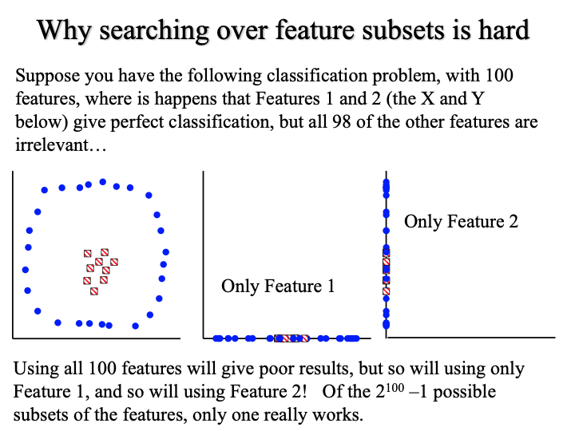
Feature Engineering
Combinations of features may be interesting, but... there may be many combinations to search!

Slide 16
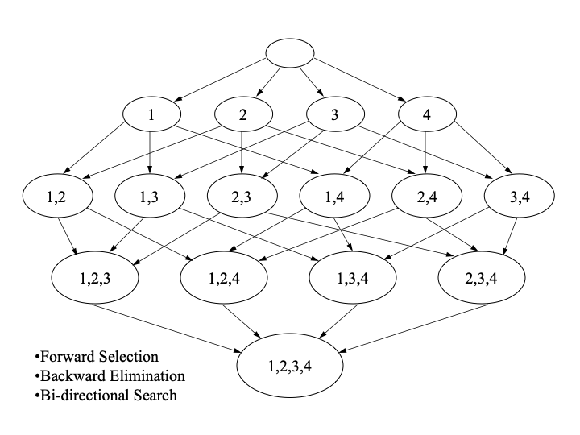
Feature Engineering
This is a search problem!
One, as some might say, where most of the magic of machine learning happens.

Slide 17
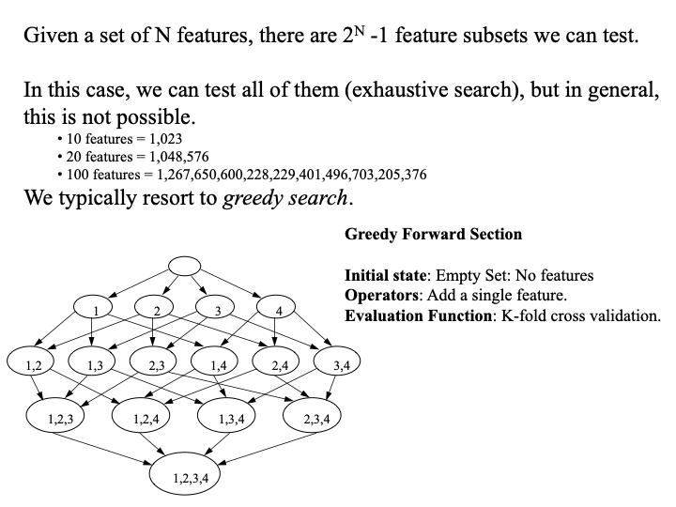
Feature Engineering
The default rate is established with no features.
Then, we can incrementally add features that greedily improve accuracy.
Feature generation:
BMI = height/weight²

Slide 18
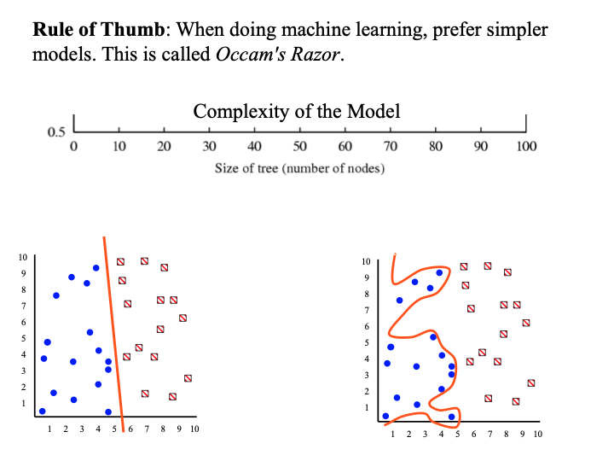
Overfitting
Simple is better.

Slide 19
Next Time...
Decision Trees
Naive Bayes
Regression
Neural Nets

